Slide 1
EATQUEST
DANNY TRAN, ADRIANA VELASCO, MARIA RIVAS, JULIE KASPARIAN

Slide 2

INTRODUCTION
EatQuest is an app that will help the user find a restaurant in their immediate vicinity. The user will be able to pinpoint exactly what kind of food they want, the price they are willing to pay, and the distance they are willing to drive to get to their food location.

Slide 3
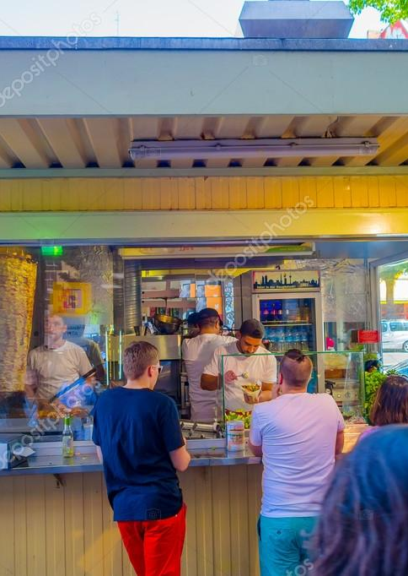
PURPOSE
The purpose of this app is to simplify the restaurant selection process; to give the user a streamlined dining experience. As a result, we only show the available restaurants in the immediate vicinity.

Slide 4



INTENDED AUDIENCE
Technologically
challenged
Pedestrians
Locals & Travelers

Slide 5
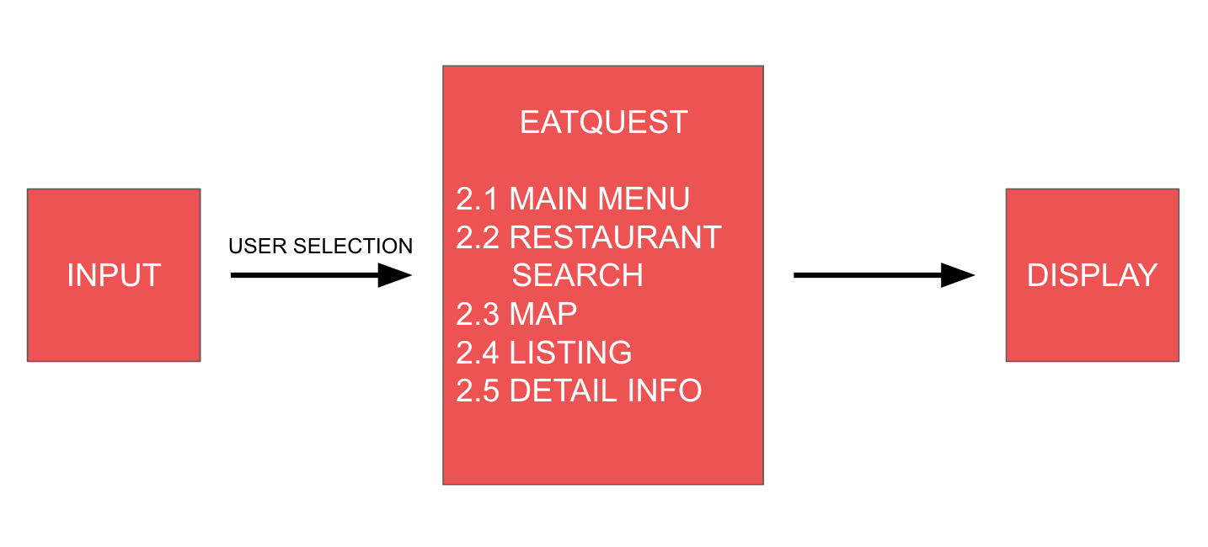
LEVEL 0 DFD

Slide 6
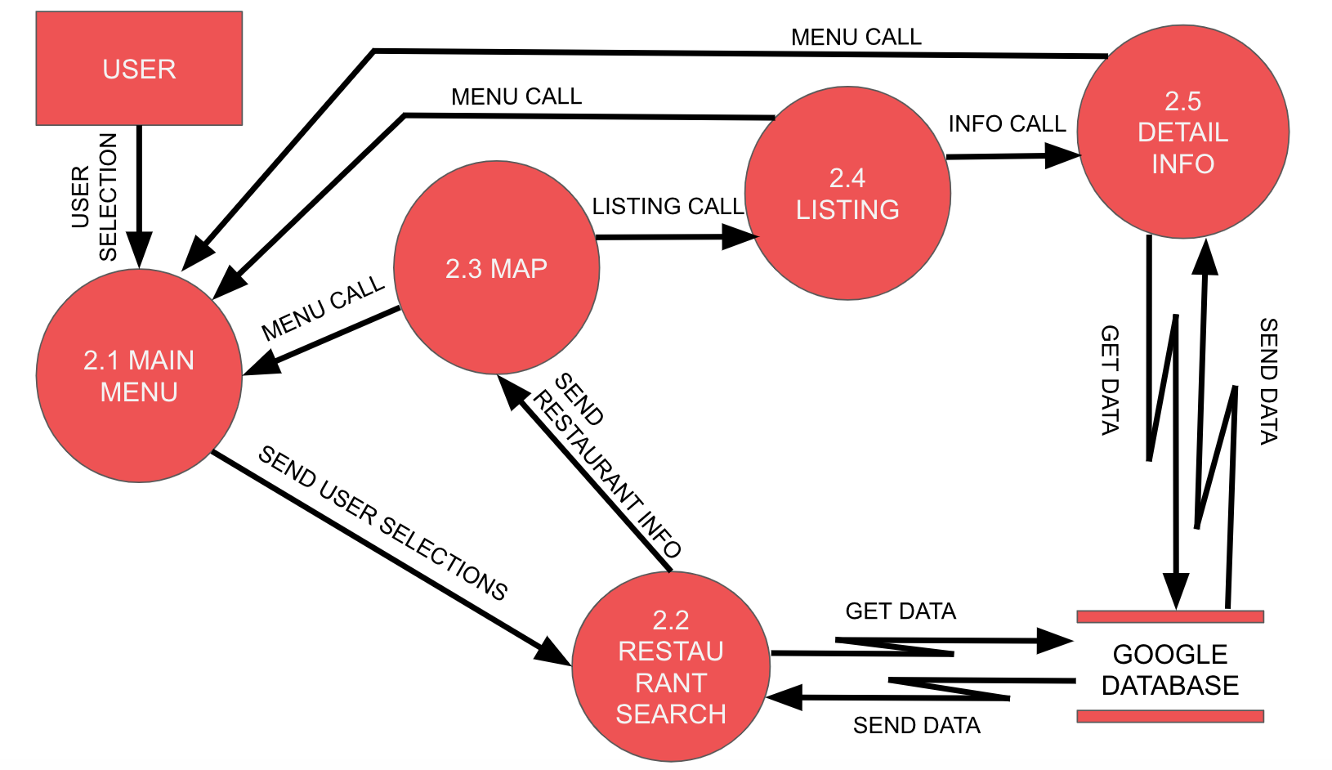
LEVEL 1 DFD

Slide 7
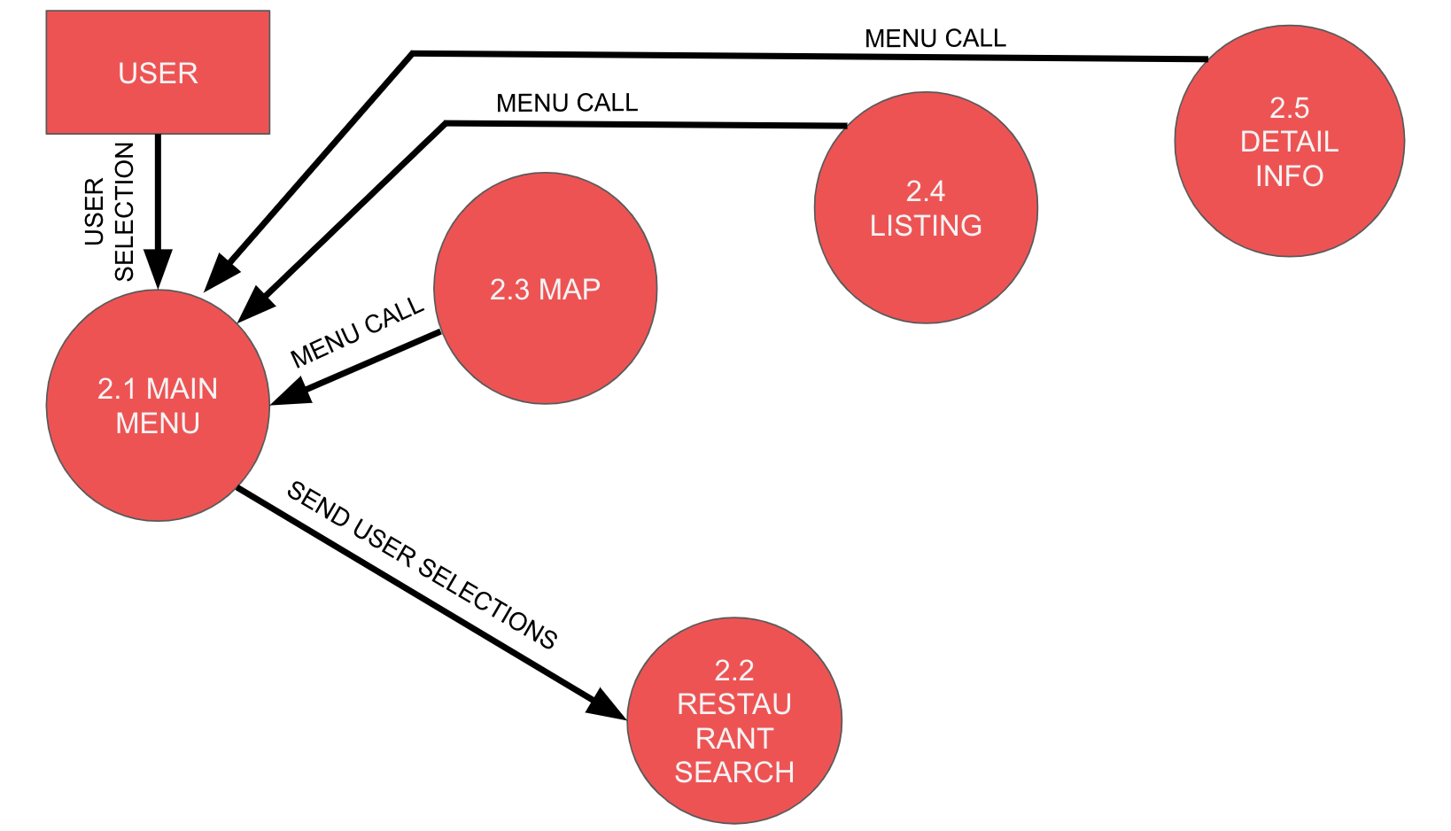
MAIN MENU MODULE (MMM)
Notes:
Unsure whether to use this one… or make a new one?

Slide 8
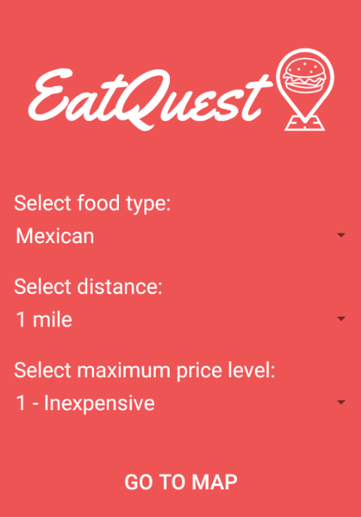
MAIN MENU MODULE (MMM)
Menu where users make their restaurant selections.
The options to choose from include food type, distance, and price level.
Notes:
The first module is the Main Menu Module. This module displays the main menu where the user will make their restaurant selections. The selections are spinners, that when clicked on, will display a dropdown menu with the available choices. The options to choose from include food type, distance, and price level. The available choices for food type are Chinese, Mexican, American, Italian, and Vietnamese. The choices for distance are 1 to 5 miles. And the choices for price level are inexpensive, moderate, expensive, and very expensive. After the user makes their choices, the “GO TO MAP” button send the data to the RSM.

Slide 9
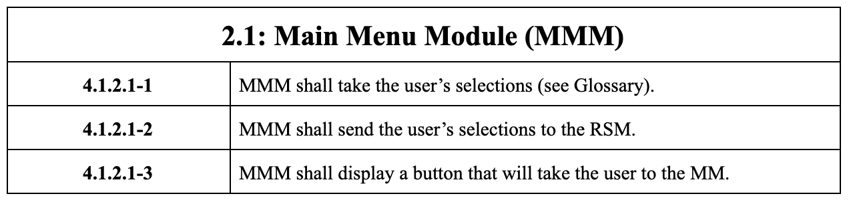
MMM REQUIREMENTS

Slide 10
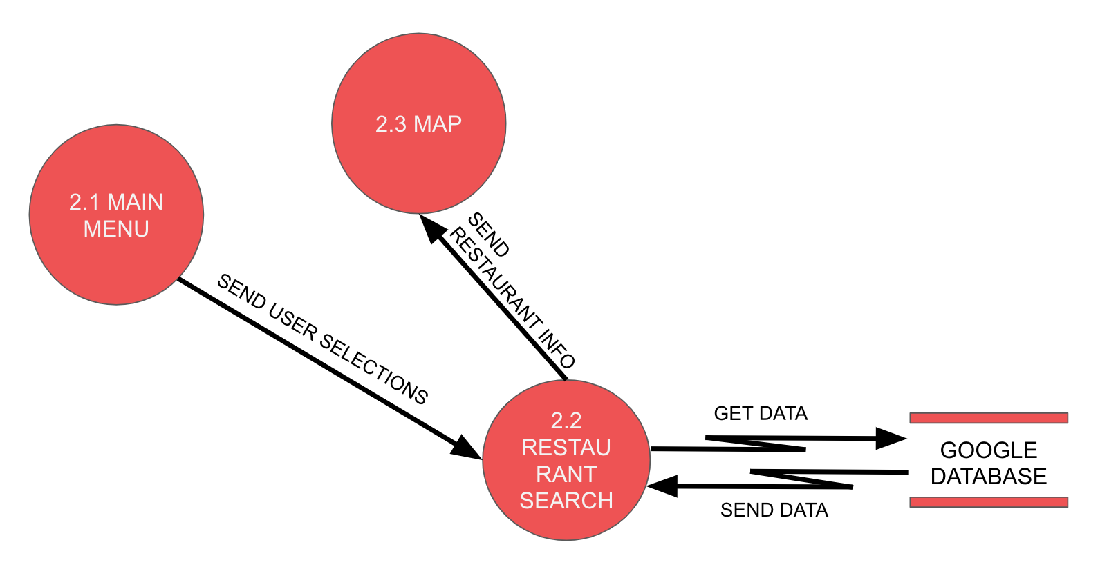
RESTAURANT SEARCH MODULE (RSM)

Slide 11
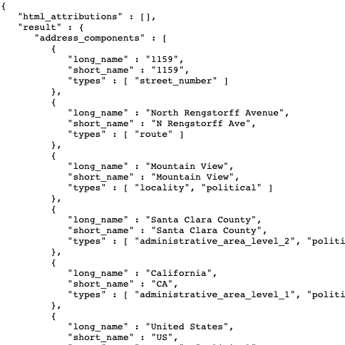
RESTAURANT SEARCH MODULE (RSM)
Uses the Places API to search the Google database for the nearby restaurant locations that fit the user’s selections.
Sends the restaurant location information to the MM and the LM.
Notes:
The third module is the Restaurant Search Module. This module receives the user’s selections from the main menu module and searches the Google database for nearby restaurants that fit the user’s selections. This is done with the Places API which is a service that returns information about places using HTTP requests. The Places API sends an HTTP URL request with specified parameters and returns nearby restaurant locations within the selected distance of the user’s current location. After the module gets the restaurant locations it sends the information to the Map Module and the Listings Module.

Slide 12
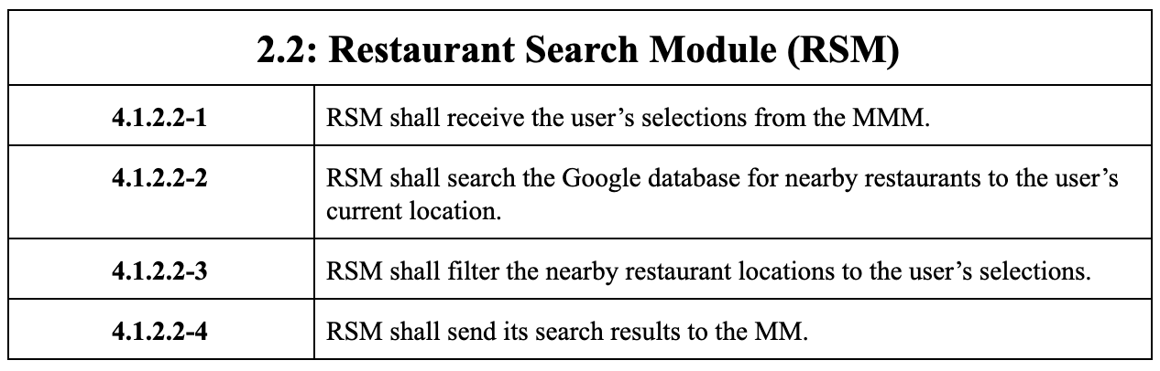
RSM REQUIREMENTS

Slide 13
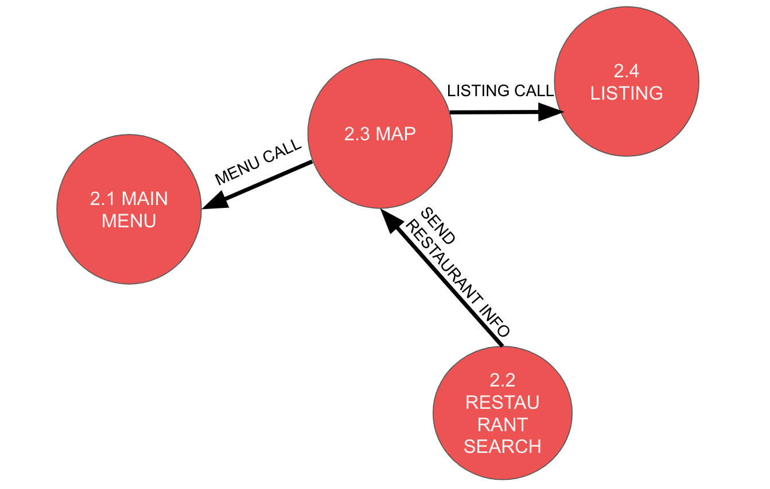
MAP MODULE (MM)

Slide 14
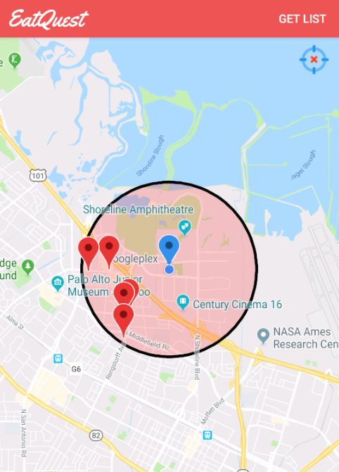
MAP MODULE (MM)
Displays map.
Tracks and displays current user location.
Displays nearby restaurant locations around user’s current location.
Target button orients user to their current location on map.
Notes:
The Map Module module uses the Google Maps API to display the map. It will get the user’s current location using a fused location provider and display it with a marker. The fused location provider is a location API in Google Play services that combines different signals to provide the location information that the app needs. The module will also receive the locations of the nearby restaurants from the restaurant search module and display them with markers on the map. A button will also be displayed that will orient the user back to their current location if they move too far on the map. There will also be a “Get List” button that will take the user to the listings module, which is a page of all of the nearby restaurants in list form.

Slide 15
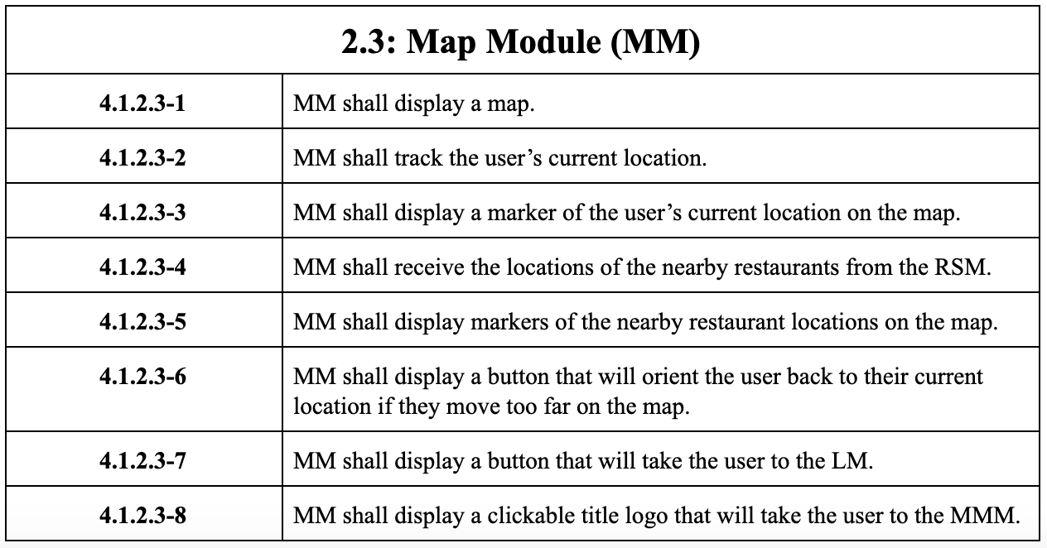
MM REQUIREMENTS

Slide 16
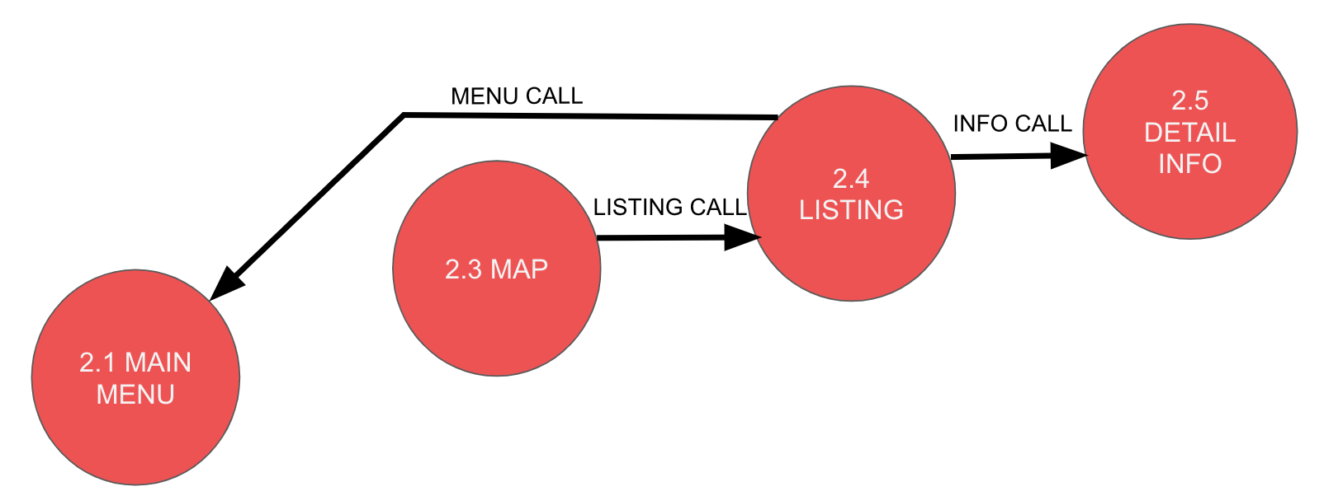
LISTING MODULE (LM)
Notes:
One line about dfd

Slide 17
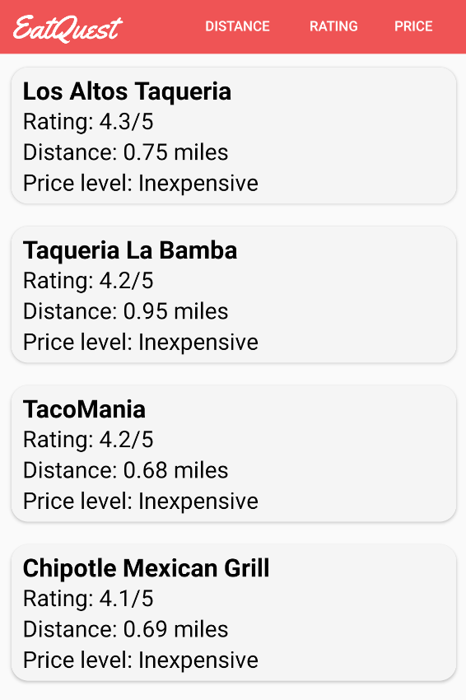
LISTING MODULE (LM)
List of nearby restaurants.
Displays restaurant name, rating, distance, and price level.
Sorting buttons for distance, rating, and price level.
Notes:
Talk about the module

Slide 18
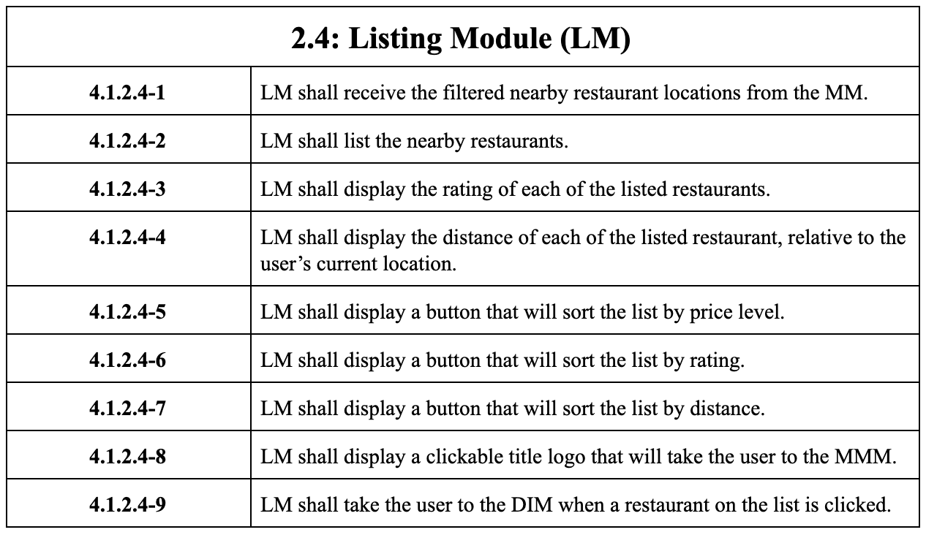
LM REQUIREMENTS
Notes:
One line about the requirements (if we implemented all of it)

Slide 19
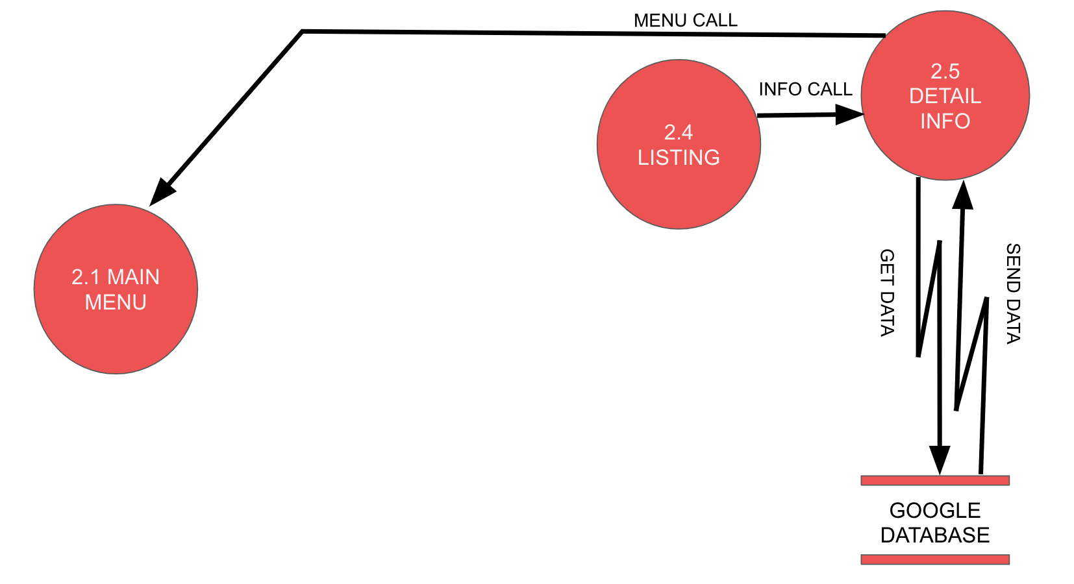
DETAIL INFO MODULE (DIM)

Slide 20
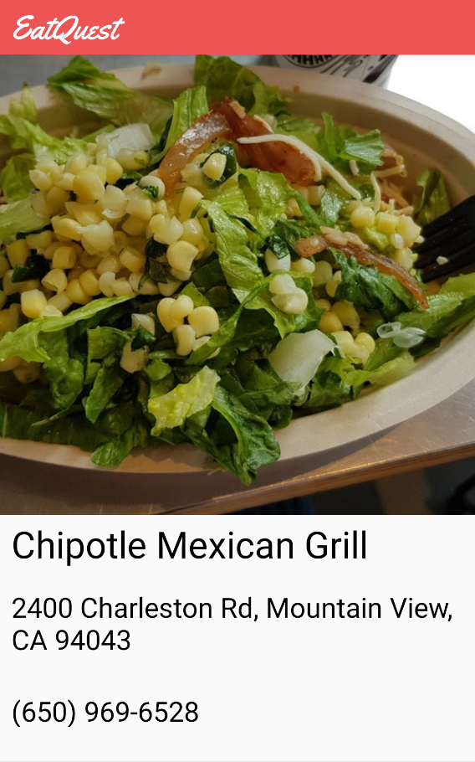
DETAIL INFO MODULE (DIM)
DETAIL INFO MODULE (DIM)
Restaurant photo
Address
Phone number

Slide 21
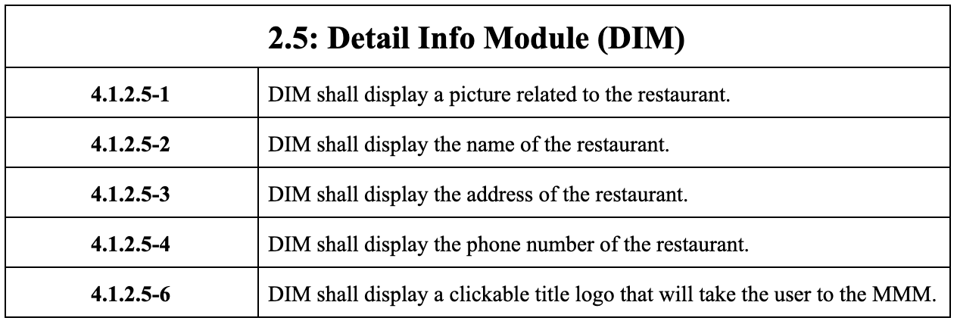
DIM REQUIREMENTS

Slide 22
DEMO

